Slide 1
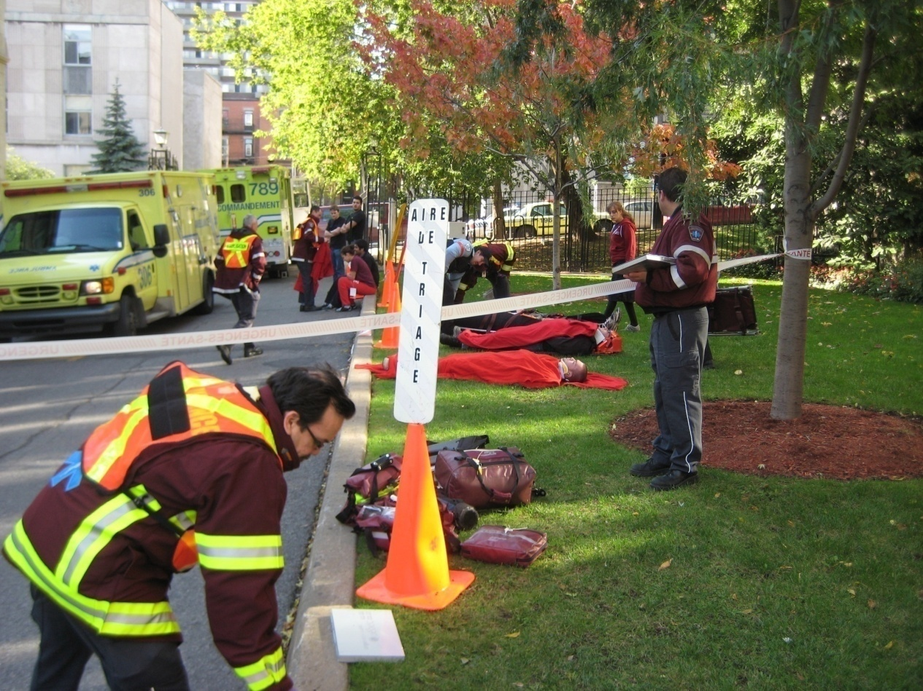
START Triage:
Beyond Red, Yellow, Green and Black
Adapted from a presentation by:
Lou E. Romig MD, FAAP, FACEP, Miami-Dade Fire Rescue

Slide 2
What is Triage?
“Triage” means “to sort”
Looks at medical needs and urgency of each individual patient
Sorting based on limited data acquisition
Also must consider resource availability

Slide 3
Primary Disaster Triage
Goals:
1) to sort patients based on probable needs for immediate care.
2) Also to recognize futility.

Slide 4
Why Should Responders Care About Good Triage?
Provides a way to draw organization out of chaos
Helps to get care to those who need it and will benefit from it the most
Helps in resource allocation
Provides an objective framework for stressful and emotional decisions

Slide 5
Daily Emergencies
Do the best for each individual.
Disaster Settings
Do the greatest good for the greatest number. Maximize survival.

Slide 6

Triage is a dynamic process and is usually done more than once.

Slide 7
START
Simple Triage And Rapid Treatment
Developed jointly by Newport Beach (CA) Fire and Marine Dept. and Hoag Hospital (early 1980s)

Slide 8
Triage Categories
Red:
  Life-threatening but treatable injuries requiring rapid medical attention
Yellow:
  Potentially serious injuries, but are stable enough to wait a short while for medical treatment

Slide 9
Triage Categories
Green:
  Minor injuries that can wait for longer periods of time for treatment
Black:
  Dead or still with life signs but injuries are incompatible with survival in austere conditions

Slide 10
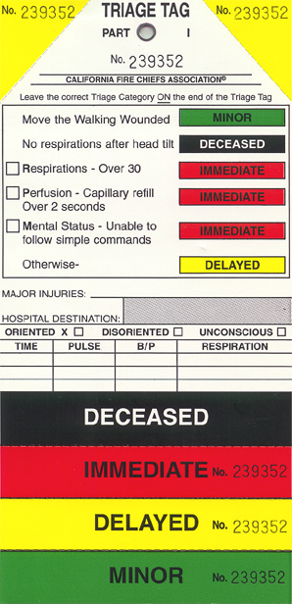
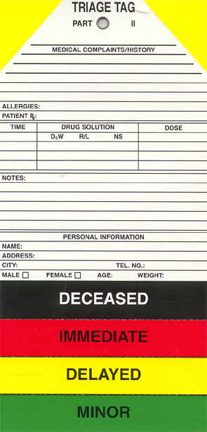

Slide 11
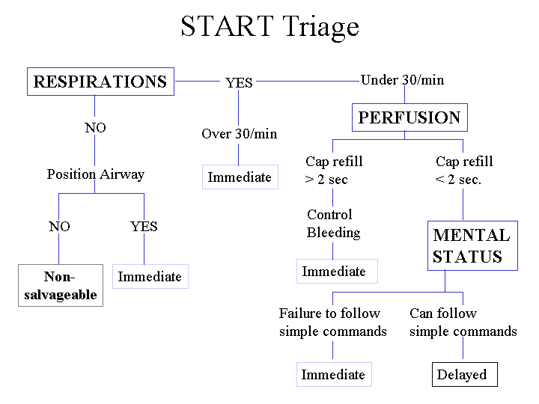

Slide 12
START: Step 1
Triage officer announces that all patients that can walk should get up and walk to a designated area for eventual secondary triage.
All ambulatory patients are initially tagged as Green.

Slide 13
START: Step 2
Triage officer assesses patients in the order in which they are encountered
Assess for presence or absence of spontaneous respirations
If breathing, move to Step 3
If apneic, open airway
If patient remains apneic, tag as Black
If patient starts breathing, tag as Red

Slide 14
START: Step 2 - continued
Assess respiratory rate
If ≤ 30, proceed to Step 4
If > 30, tag patient as Red

Slide 15
START: Step 3
Assess presence or absence of radial pulse
Present: move to step 4
Absent: tag as Red
Alternative: capillary refill
(ok if ≤ 2 seconds)

Slide 16
START: Step 4
Assess mental status
If able to obey commands, tag as Yellow
If unable to obey commands, tag as Red

Slide 17
Mnemonic
R
P
M
30
2
Can do

Slide 18
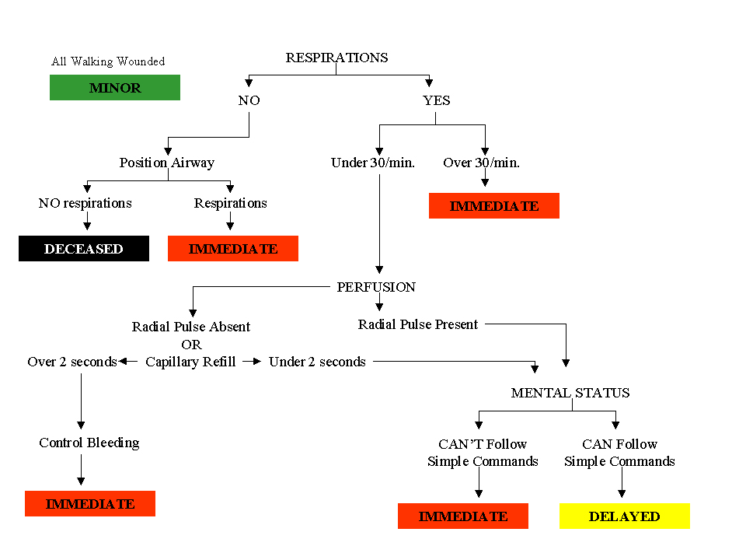

Slide 19
JumpSTART Pediatric MCI Triage
Developed by Lou Romig MD, FAAP, FACEP
Only recognized pediatric MCI primary triage tool used in the US & Canada
Being taught around the world

Slide 20
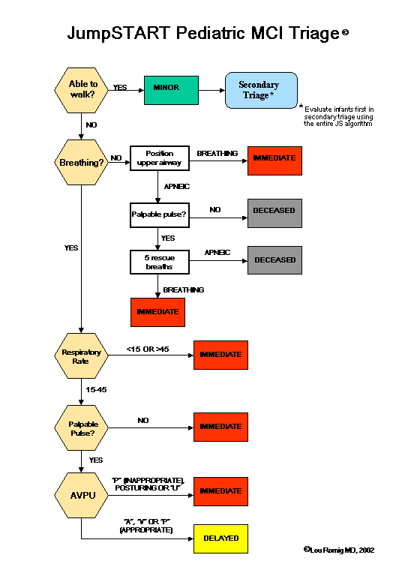

Slide 21
Modification for Nonambulatory Children
Children developmentally unable to walk due to young age or developmental delay
Children with chronic disabilities that prevent them from walking

Slide 22
Modification for Nonambulatory Children
If pt meets any red criteria tag as red
If patient meets yellow criteria, tag as yellow

Slide 23
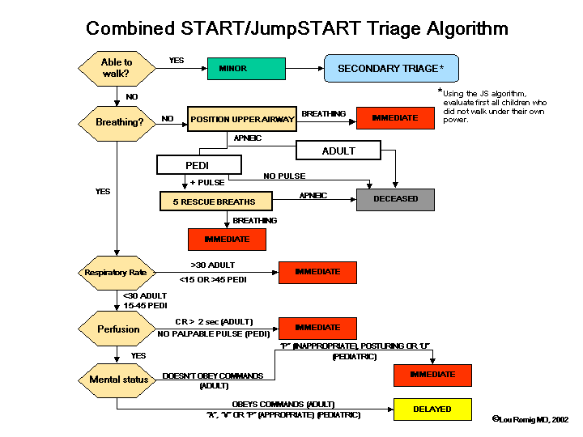

Slide 24
32 yo female, multiple fractures to both legs
Skin: pale, warm, dry
Respiration : 24/min, GAEB
Radial pulse: strong
Capilary refill: 2 seconds
Neurologic status : oriented, obeys command
PMH : none
WHAT IS THE TRIAGE COLOR?

Slide 25
32 yo female, multiple fractures to both legs
Skin: pale, warm, dry
Respiration : 24/min, GAEB
Radial pulse: strong
Capilary refill: 2 seconds
Neurologic status : oriented, obeys command
PMH : none
WHAT IS THE TRIAGE COLOR?
YELLOW

Slide 26
10 yo boy, impaled by a branch
Skin: pale, cool, clammy
Respiration : superficial at 12/min
Radial pulse : rapid, weak, regular
Capillary refill : 4 seconds
Neurologic status : conscious, reacts to pain
PMH: unknown
WHAT IS THE TRIAGE COLOR?

Slide 27
10 yo boy, impaled by a branch
Skin: pale, cool, clammy
Respiration : superficial at 12/min
Radial pulse : rapid, weak, regular
Capillary refill : 4 seconds
Neurologic status : conscious, reacts to pain
PMH: unknown
WHAT IS THE TRIAGE COLOR?
RED

Slide 28
Adult female, unconscious, injured by explosion
Skin: cyanosed, cold, clammy
Respiration : absent after opening the airway
Radial pulse: absent
Capillary refill: not done
Neurologic status : no verbal response
Secondary survey : deformed left leg, facial & thoracic wounds.
WHAT IS THE TRIAGE COLOR?

Slide 29
Adult female, unconscious, injured by explosion
Skin: cyanosed, cold, clammy
Respiration : absent after opening the airway
Radial pulse: absent
Capillary refill: not done
Neurologic status : no verbal response
Secondary survey : deformed left leg, facial and thoracic wounds.
WHAT IS THE TRIAGE COLOR?
BLACK

Slide 30
Panicked female, holding right arm and screaming
Skin : cold, dry
Respiration : 24/min, regular
Radial pulse : rapid, strong
Capillary refill: not done
Neurologic status: verbal, ambulatory
pmh : sickle cell
Physical exam : deformed right wrist
WHAT IS THE TRIAGE COLOR?

Slide 31
Panicked female, holding right arm and screaming
Skin : cold, dry
Respiration : 24/min, regular
Radial pulse : rapid, strong
Capillary refill: not done
Neurologic status: verbal, ambulatory
pmh : sickle cell
Physical exam : deformed right wrist
WHAT IS THE TRIAGE COLOR?
GREEN

Slide 32
Key Points about MCI Triage
All victims must have equal importance at the time of primary triage.
No patient group can receive special consideration other than that dictated by their physiology.
This includes children!

Slide 33
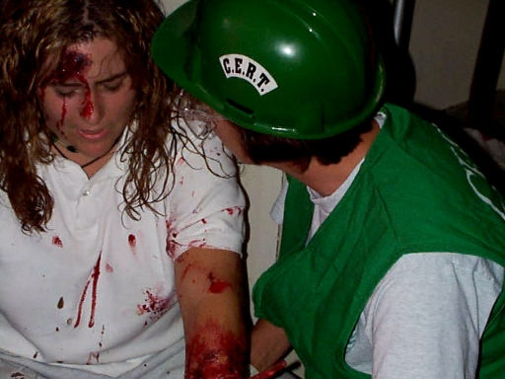
Key Points about MCI Triage
MCI triage will never be logistically, intellectually, or emotionally easy…
but we must be prepared to do it using the best of our knowledge and abilities.

Slide 34
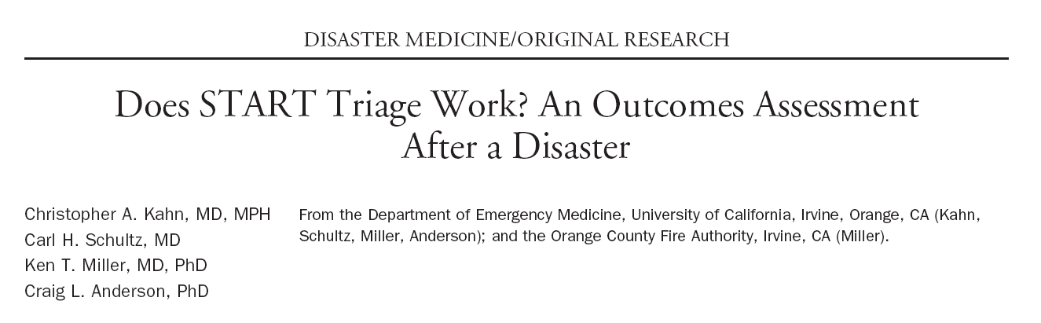
START: Does it work?
Ann Emerg Med. 2009; 54: 424-430

Slide 35
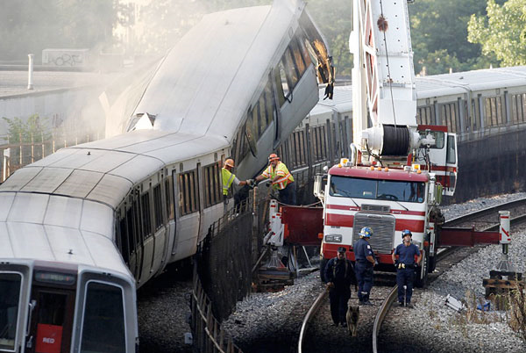
April 23, 2002: 8h10 AM, California

Slide 36
START: Does it work?
162 victims triaged with the START tool by paramedics (n=148 patients included)
Looked at patient outcomes for each triage color (modified Baxt criteria)
53% overtriage and 2% undertriage
Red patients arrived 1h prior to the yellow and green patients
Overtriage → Overutilisation of ressources
Ann Emerg Med. 2009; 54: 424-430

Slide 37
START: Does it work?
Limitations:
  Inadequate triage or………… ……..inadequate tool???
  7 ambulatory patients on scene were triaged as yellow and red
  14 missing charts

Slide 38
Triage Tools
START
Jump START
Homebush
Triage Sleve
Pediatric Triage Tape
CESIRA
CareFlite
Sacco Triage Method
Military Triage
SALT

Slide 39
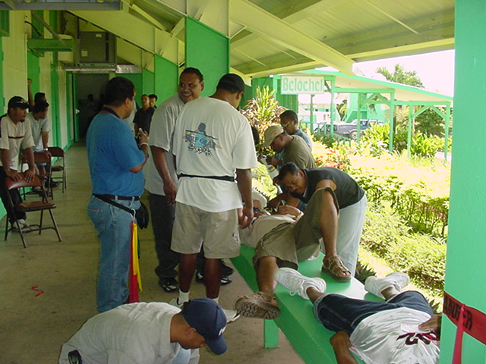
The Best Tool?
No MCI primary triage tool has been validated by outcome data.

