Slide 1
Public meeting
McGill University Health Centre
Board of Directors
December 10, 2018
16:30 - 18:00

Slide 2
Peter Kruyt
Chairman – MUHC Board of Directors
Call to Order
Quorum
Approval of the Agenda
Chairman’s Remarks
Approval of the Consent Items Resolutions

Slide 3
Dr. Pierre Gfeller
President and Executive Director
6. Report of the President and Executive Director
6.1 Update by the President Executive Director

Slide 4
6.2 The Mental Health Mission:
Past, present and future
Dr. Nadia Szkrumelak
Psychiatrist-in-Chief of the Mental Health Mission
Antoinette Di Re
Director, Multidisciplinary Services (adult sites), Mental Health Mission and Patient Trajectory NSA/SAPA

Slide 5
Outline of Presentation
Our Mission trajectory
Who is the Mental Health Mission
Portrait of the Mission and challenges
Quality activities
Priorities 2018 to 2020
Conclusion
Questions

Slide 6
Our Mission Trajectory
2007: Merger of ambulatory services (AMI & MGH)
2012: Merger of In-Patient Units (AMI & MGH)
      From 93 to 49 beds in total
2015: Emergency Psychiatry Unit and BIU (MGH)
      42 beds
2018: In-Patient unit down to 40 beds + 6 beds BIU
To come: Consolidation of Mental Health services at the MGH site
Notes:
Nadia

Slide 7
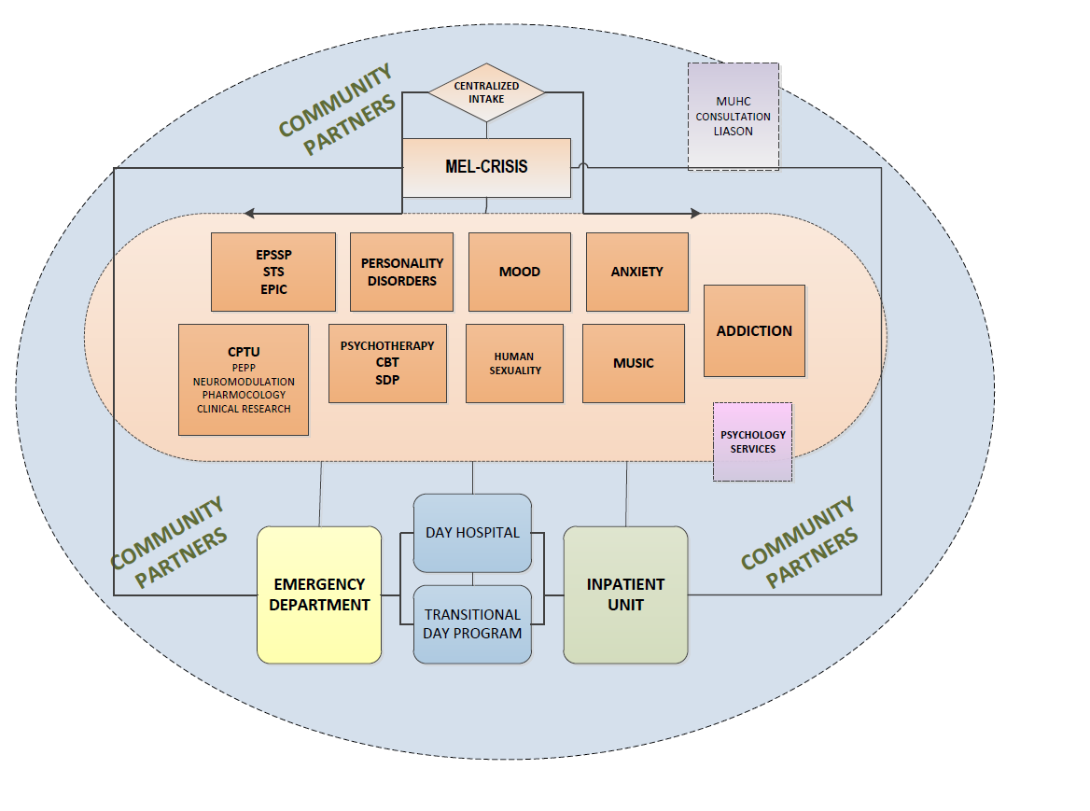
Our MH Continuum of Service
SIM team
Notes:
Mental health continuum of service: Complex specialized services -Need to take a collaborative system approach to optimizing the patient’s journey along the continuum

Slide 8
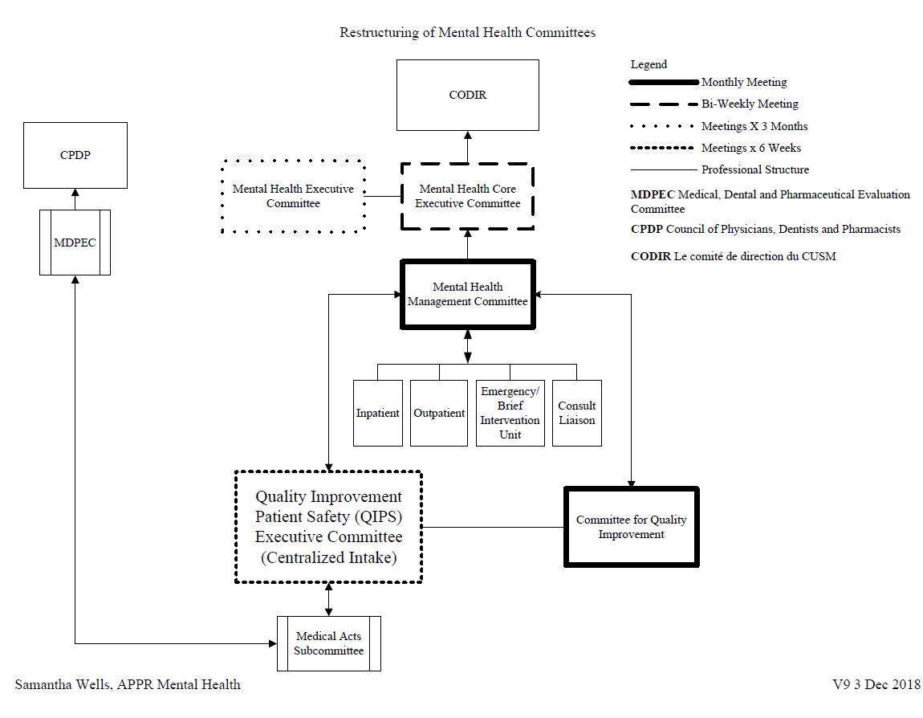
Mental Health Mission Structure

Slide 9
Mental Health Mission
Ambulatory services
12 OPD clinics and 5 programs
Over 45 000 visits annually
Day Hospital (AMI) and Transition Day Program (MGH)
Neuromodulation
SIM team
CHALLENGES:
AMI isolated –need to integrate all Mental Health services at the MGH site
SIM team incomplete (6 instead of 10)
SIM team created at the expense of other out-patient programs (mandatory but no funding)
Notes:
based on interdisciplinary model
collaborations with the community partners
waiting lists are short ( 2-4 weeks) for most clinics
comprehensive approach for co-morbidities
integrated teaching and research

Slide 10
Mental Health Mission
Acute care Unit
As of Jan 2018: 40 beds ( 3-4 addictions program) on the 4th floor and 6 in BIU
4th floor often running overcapacity
CHALLENGES:
Length of stay
Number and length of stay of NSAs “hors-délais”
Notes:
based on interdisciplinary model
collaborations with the community partners
waiting lists are short ( 2-4 weeks) for most clinics
comprehensive approach for co-morbidities
integrated teaching and research

Slide 11
Mental Health Mission
Psychiatry LOS – 4th floor
NSA data 2017-2018
  79% of patients discharged under NSA status on the psychiatry unit were “hors délai”
  An average of 24.78% of the beds on the psychiatry unit were occupied by patients under NSA status

Slide 12
Mental Health Mission
Psychiatry LOS – 4th floor
Total
NSA
Sans NSA

Slide 13
Mental Health Mission
Psychiatry Emergency Department
Increase in the number of visits by 18% since 2015
CHALLENGE:
Patients waiting for in-patient beds > 48 hours

Slide 14
Mental Health Mission
Consult-Liaison service
Referrals and follow up for all in-patient sites and Missions as well as some outpatient specialty activities (eg. cancer care, nephrology, obstetrics)
Complex health and/or high risk situations with patients and families
Teaching and support to staff for patients with psychiatric/behavioral problems
Support for Confinement procedures and decision-making
Challenge:
Increasing demand for consultations for complex patients with psychiatric/behavior

Slide 15
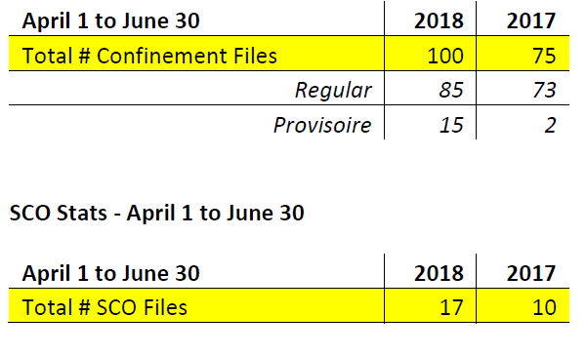
Mental Health Mission
Legal Activities
Continued and steady increase in the number of:
  Superior Court Order hearings
  Tribunal Administratif du Québec hearings
  Requests for confinements
    Regular
    Provisional
Garde provisoire – comparison 2017 and 2018
Challenges: Burden on legal services and increase in LOS

Slide 16
Quality Activities Mission
Dashboard – close monitoring of multiple indicators
Restructuring of CQI, M&M and Medical acts committee to create Quality Improvement and Patient Safety (QIPS) Committee
  One central intake
  Encourage reporting of incidents (anonymous)
  Multidisciplinary, moving towards interdisciplinary
  Participation of residents in the education component
  Focus on recommendations and ensure follow up
Patient and family partnership
  Recovery Transition Program

Slide 17
Quality Activities Mission
Optimization of Patient Trajectory Project – working with our partners
Individualized Intervention Plan (PII) for all patients
Expected date of discharge determined within 48 hrs of admission
Implication of patient and family in all care processes, including expected date of discharge, starting from the ED and on the in-patient unit.

Slide 18
Priorities for 2018-2020
Consolidation of ambulatory services at MGH (move of the AMI)
Optimization of patient trajectory
Accreditation May 2019
Partnership: continuing initiatives with patients and families
Safety: Protocol de collaboration ( SPVM-MUHC); review of Code White practices and safety of the environment
Ongoing partnership with MGH Foundation

Slide 19
Conclusion: SWOT analysis
Strengths
  Successful, ongoing integration as per clinical plan
  Co-management and patient/family partnership
  Open relationship with MSSS
  Dedicated staff
Weaknesses
  Patient trajectory – more gains to be made
    Need to further decrease the length of stay, reduce the number of patients > 48hrs in ED, reduce the number of NSA patients ‘hors délai’
  Electronic documentation remains challenging
Opportunities
  Partnerships with CIUSSS Centre-ouest and Ouest-de-l’île
  Recognition of our tertiary mandate
  Plan d’action santé mentale 2015-2020 (funded NSA positions)
Threats
  Institution non-fusionnée but with a territorial responsibility
  Funding for professionnals (eg. SIM program)

Slide 20

Mental Health Mission
Thank you!

Slide 21
6.3 Report from the User’s Committee
Amy Ma & Seeta Ramdass, Co-Chairs

Slide 22
Land acknowledgement statement
We would like to begin by acknowledging that the MUHC is located on unceded Indigenous lands. The Kanien’kehá:ka Nation is recognized as the custodians of the lands and waters on which we gather today.
Tiohtiá:ke/Montreal is historically known as a gathering place for many First Nations. Today, it is home to a diverse population of Indigenous and other peoples. We respect the continued connections with the past, present and future in our ongoing relationships with Indigenous and other peoples within the Montreal community.

Slide 23
MUHC USERS’ COMMITTEE
ANNUAL REPORT 2015-2016
RAPPORT ANNUAL 2017-2018

Slide 24
RÉALISATIONS MAJEURES
GOUVERNANCE
Conférence de presse
Recrutement des membres du CA
Formation comment militer au sein d’un comité des usagers

Slide 25
RÉALISATIONS MAJEURES
ACCÈS AUX SOINS
Salon Viséz Droit
Office d’Éducation des patients
Programme L’Atelier
Programme de soins suite au cancer

Slide 26
Plaintes et demandes d’assistance

Slide 27
PLAINTES ET DEMANDES D’ASSISTANCE
Dans l’ordre de leur fréquence
Demande de renseignements et d’aide: 45
Qualité des soins: 37
Accès aux soins et continuité des soins: 28
Accès par téléphone: 22
Qualité des services: 14
Attente dans clinique ou dans salle d’urgence: 14
Communication interpersonnelle: 10
Accessibilité et aménagement fonctionnel: 6
Attente d’une chirurgie ou d’une procédure opératoire: 6
Signalétique: 6
Demande d’accompagnement: 6
Langue: 5
Stationnement: 4
Facturation: 3
Objet perdu ou volé: 3
Ordonnance d’un tribunal (patient psychiatrisé): 2
Entretient ménager: 2
Atteinte à la vie privée ou à la confidentialité: 2
Autre motif: 13
TOTAL: 213*
*Note: Some of the complaints received involved more than one category.

Slide 28
LES ENJEUX ACTUELS
Accessibilité et aménagement fonctionnel
Les soins et la culture autochtone
Attente dans clinique
OPAL

Slide 29
PARTICIPATION À D’AUTRES COMITÉS
Conseil d’administration du CUSM
Conseil des infirmières et infirmiers du CUSM
Comité de gestion de la qualité et des risques
Table de Concertation sur Patient Partenariat
Council on Services to Children and Adolescents (CSCA)
Comité des services de consultation socioculturelle et d’interprétation de l’HME
Comité de vigilance
Comité des services de stationnement du CUSM
Comité de l’accès téléphonique

Slide 30
MEDIA
May 25, 2017: The Montreal Gazette: MUHC bickering leaves patients feeling caught in the middle.
July 10, 2017: The Montreal Gazette: Barrette in denial about patient suffering.
January 24, 2018: La Presse: Enfants autochtone: une pratique d’évacuation « barbare ».

Slide 31
EXTRA MUROS
Conseil pour la protection des malades (CPM)
Strategy for Patient-Oriented Research (SPOR) (Canadian Institutes of Health Research)
Comité des Usagers du CHUM

Slide 32
FINANCIAL REPORT
REVENUE MSSS ALLOCATION
EXPENDITURE
$80 000 CUC
$ 2 000 CHSLD Inpatients
$ 8,446 Carry forward
Total $90,446
SURPLUS $3 252
Salaries $43,156
Local meetings & conferences $12,036
External conferences $19,901
Printing, graphics $ 9,226
Services, Fees $ 500
Office supplies, postage $ 2,375
Total $87 194

Slide 33
MERCI!

Slide 34
6.4 Research Update
Dr. Bruce Mazer, MD
Executive Director & CSO (Interim)
RI-MUHC

Slide 35


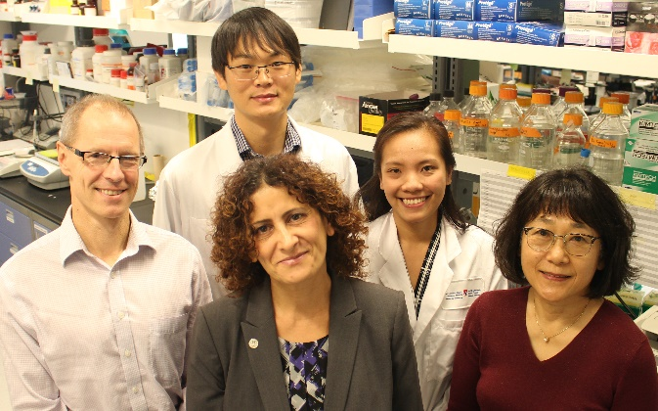
Top 40 Research Hospitals Results 2018
Trottier Webster Innovation Grants announcement
Successful Cruess Campaign
Dr N. Jabado: Discovery of Tim-3 Molecule in Immune System Regulation
Dr N. Pai: Development of app for HIV self-testing in Canada
Dr G. Gobbi: Pain relief without the high
Dr R. Slim: Identification of new genetic causes linked to abnormal pregnancies and miscarriages
Dr D. van Meyel: New mechanism for sleep regulation found in fruit flies
Drs A. Daftary, T. Gyorkos, N. Pai: Named first Canadian women in international Global Health list
#1 IN QUEBEC

Slide 36
Thank You!

Slide 37
7. Varia

Slide 38
Vos hôpitaux, Vos questions
https://cusm.ca/questions/form/vos-h%C3%B4pitaux-vos-questions
Your Hospital, Your Questions
https://muhc.ca/questions/form/your-hospitals-your-your-questions

Slide 39
8. Question Period

Slide 40
9. Termination

